Slide 1
CRI3I3 Pemrograman Perangkat Bergerak
Layout (2)

Slide 2
Outline
Nested Row/Column
Tabview
Pageview
Safe area

Slide 3

Nested Column/row
Columns and Rows are built so that they pass an infinite constraint along the main axis to their children (in our case to a nested Column or Row).
If we use column and row like that, children don’t know the maximum height (or width, when it comes to Rows.
Therefore, we have to use nested column or row that has been passed an infinite constraint,

Slide 4
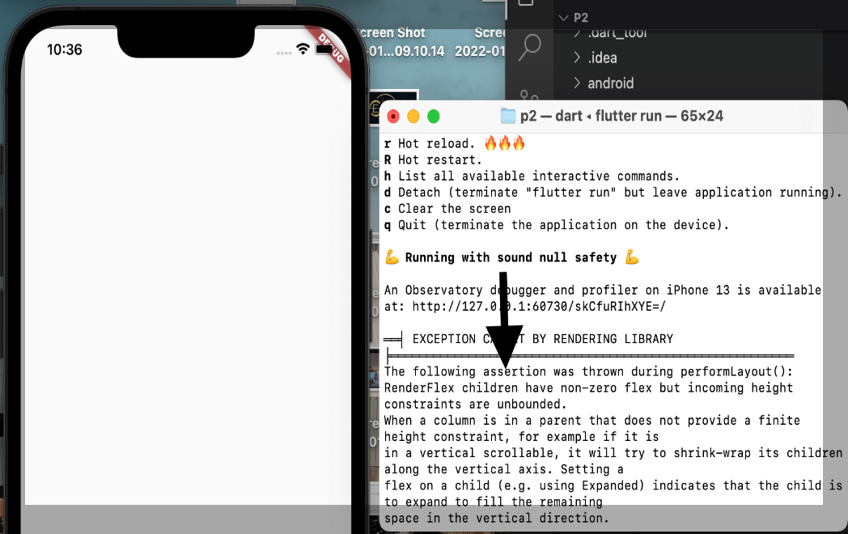
Without Wrap the column/row
@override
Widget build(BuildContext context) {
return Scaffold(
body: Column(
children: [
Column(
children: [
Expanded(
child: Container(color: Colors.red),),
],),
],),);}

Slide 5
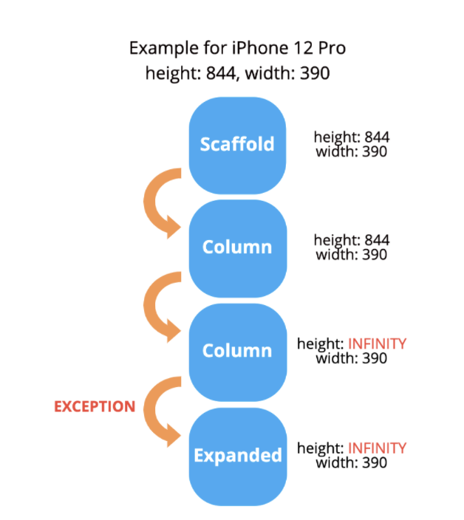
WHY?
Columns and Rows are built so that they pass an infinite constraint along the main axis to their children (in our case to a nested Column or Row). However, children don’t know the maximum height (or width, when it comes to Rows), which causes the exception shown above
Notice that Column has a vertical main axis, so it passes an infinite height down the widget tree.

Slide 6
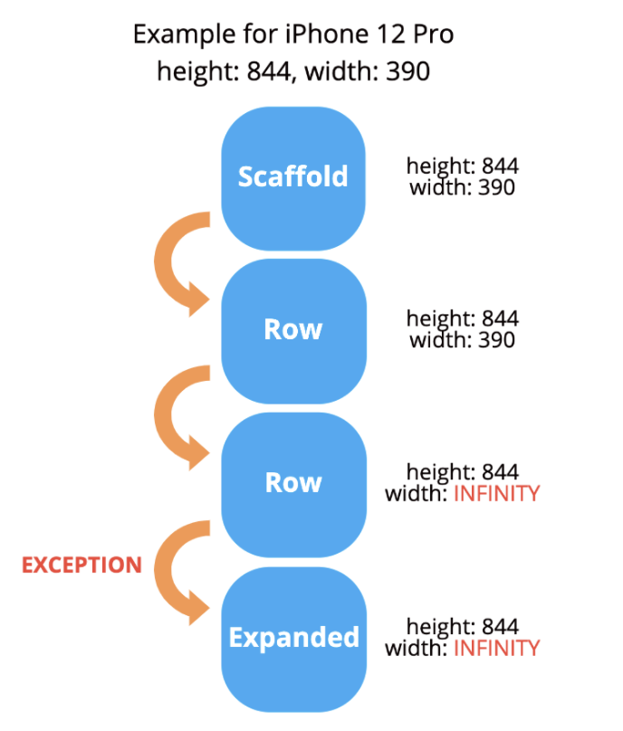
WHY?
A similar situation is when it comes to the Row widget but, in this case, the main axis is horizontal, so it passes an infinite width down the widget tree.

Slide 7
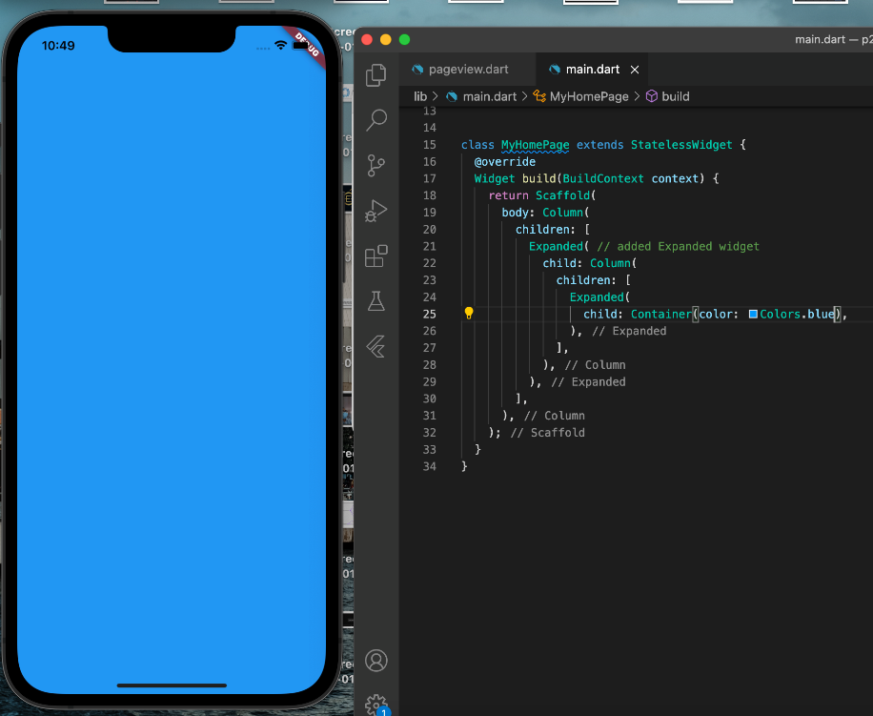
Nested Column/row
@override
Widget build(BuildContext context) {
return Scaffold(
body: Column(
children: [
Expanded( // added Expanded widget
child: Column(
children: [
Expanded(
child: Container(color: Colors.blue),),
],),
),],
),);}

Slide 8
Outline
Nested Row/Column
Tabview
Pageview
Safe area

Slide 9
Tabview
For the first to create tab is DefaultTabController
There is 2 option to use the tabview
TabBar: It is used to display the top view of tabs or more specifically it displays the content of the tab.
TabBarView: It is used to display the contents when a tab is pressed.

Slide 10
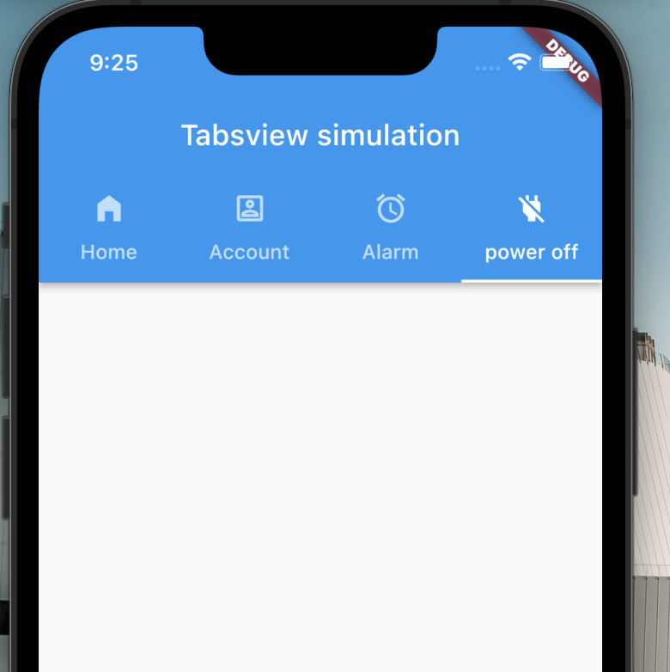
Tabview (Tab Bar)
home: DefaultTabController(
length: 3,
child: Scaffold(
appBar: AppBar(
bottom: const TabBar(
tabs: [
Tab(icon: Icon(Icons.home_filled),text: "Home",),
Tab(icon: Icon(Icons.account_box_outlined),text: "Account",),
Tab(icon: Icon(Icons.alarm),text: "Alarm",),
],
),

Slide 11
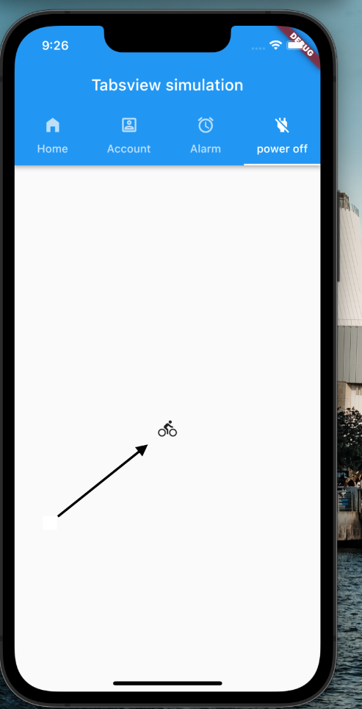
Tabview (TabBarView)
body: const TabBarView(
children: [
Icon(Icons.directions_car),
Icon(Icons.directions_transit),
Icon(Icons.directions_bike),
Icon(Icons.directions_bike),
],

Slide 12
Tabview (Scrollable)
There is any altenative for many tabs more than 3
We can use scrollable for best UX for user

Slide 13
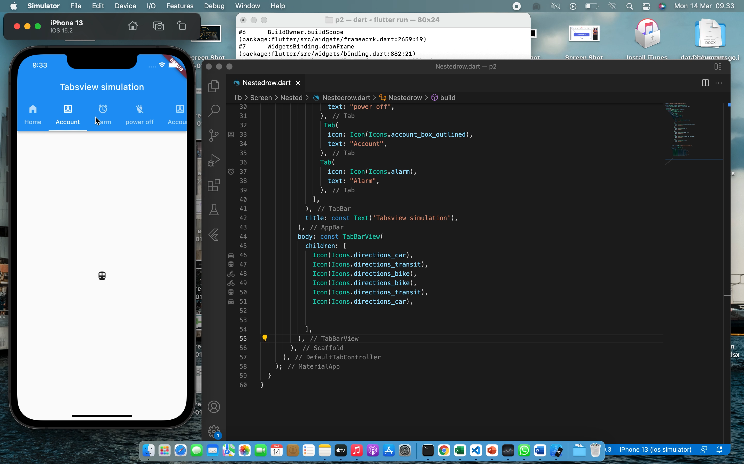
Tabview (Scrollable)
home: DefaultTabController(
length: 3,
child: Scaffold(
appBar: AppBar(
bottom: const TabBar(
tabs: [
Tab(icon: Icon(Icons.home_filled),text: "Home",),
Tab(icon: Icon(Icons.account_box_outlined),text: "Account",),
Tab(icon: Icon(Icons.alarm),text: "Alarm",),
],
),

Slide 14
Outline
Nested Row/Column
TabView
Pageview
Safe area

Slide 15
Pageview
A PageView is a widget which generates scrollable pages on the screen. This can either be a fixed list of pages or a builder function which builds repeating pages. PageView acts similar to a ListView in the sense of constructing elements.
All types of Page Views can have horizontal or vertically scrolling pages.
The types of PageView are:
PageView
PageView.builder
PageView.custom

Slide 16
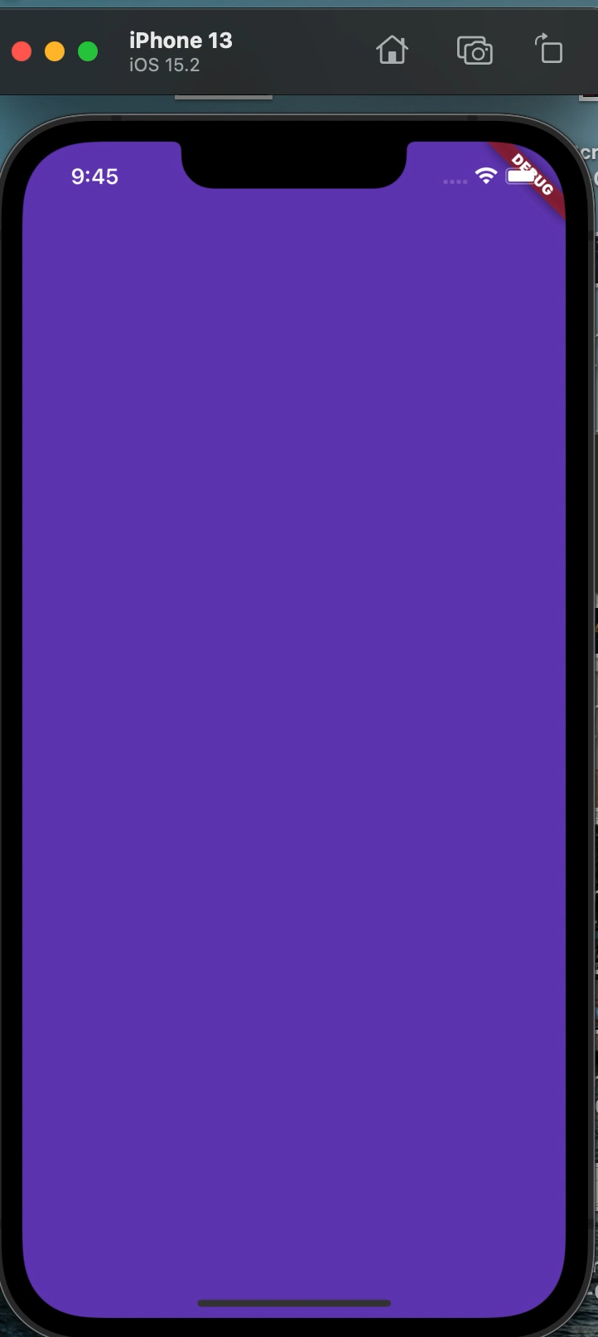
PageView (default Constructor)
This type takes a fixed list of children (pages) and makes them scrollable.
Code :
PageView(
children: <Widget>[
Container(
color: Colors.pink,
),
Container(color: Colors.cyan,),
Container(color: Colors.deepPurple,
),],)

Slide 17
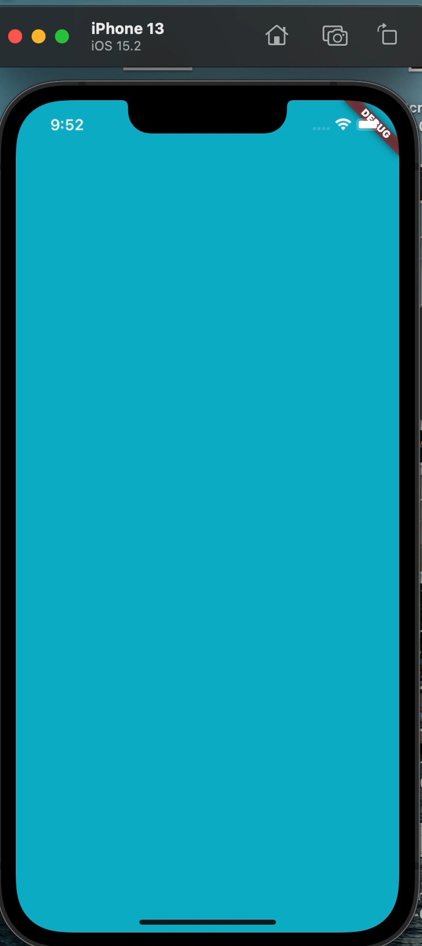
PageView.builder
Code :
PageView.builder(
itemBuilder: (context, position) {
return Container(
color: position % 2 == 0 ? Color.fromARGB(255, 255, 248, 250) : Color.fromARGB(255, 11, 179, 201), );
},
)

Slide 18
Outline
Nested Row/Column
TabView
PageView
Safe area

Slide 19
Safe Area
SafeArea is an important and useful widget in Flutter which makes UI dynamic and adaptive to a wide variety of devices. While designing the layout of widgets, we consider different types of devices and their pre-occupied constraints of screen like status bar, notches, navigation bar, etc.
In simple words, SafeArea is basically a padding widget, which adds any necessary padding to your app, based on the device it is running on. If your app’s widgets are overlaying any of the system’s features like notches, status bar, camera holes, or any other such features, then SafeArea would add padding around the app, as required

Slide 20
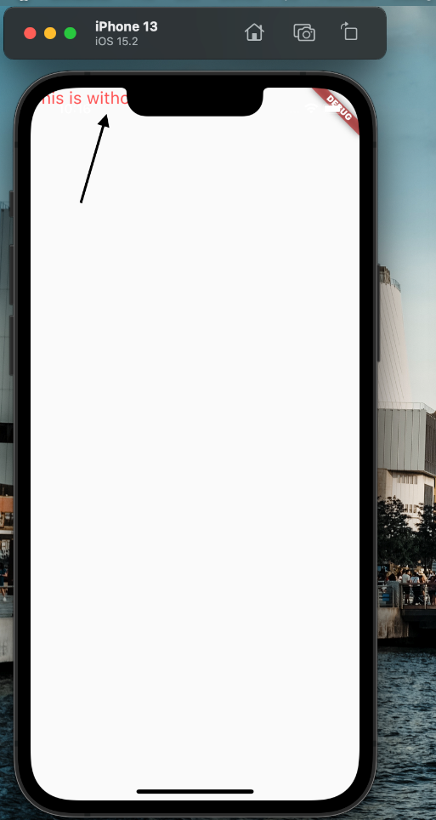
Safe Area(without)
This type takes a fixed list of children (pages) and makes them scrollable.
Code :
@override
Widget build(BuildContext context) {
return MaterialApp(
home: Scaffold(
body: Text(
'This is Example without safe area',
style: TextStyle(color: Colors.red, fontSize: 20),
),),);

Slide 21
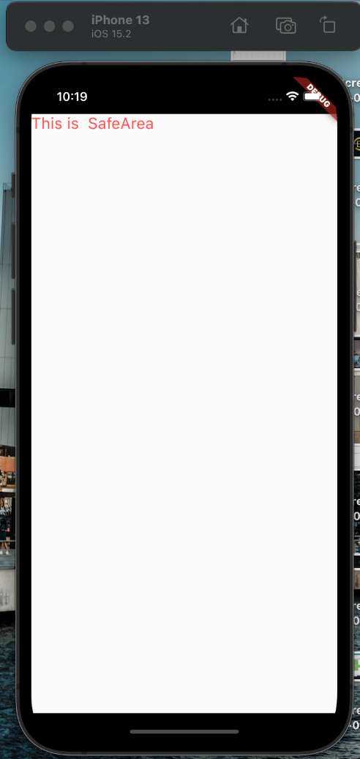
Safe Area()
In the below code, we have used SafeArea and we can see that automatically padding is added around the text and is not covering the status bar.
Code :
@override
Widget build(BuildContext context) {
return MaterialApp(
home: SafeArea(
top: true,
child: Scaffold(
body: Text(
'This is SafeArea',
style: TextStyle(color: Colors.redAccent, fontSize: 20),
),),),);

Slide 22
Reference
https://blog.codemagic.io/designing-complex-ui-using-android-constraintlayout/
https://flutter.dev/
https://blog.codemagic.io/building-responsive-applications-with-flutter/
https://medium.com/flutter-community/a-deep-dive-into-pageview-in-flutter-with-custom-transitions-581d9ea6dded

